Slide 1
Symbol Table
Symbol table is used widely in many applications.
  dictionary is a kind of symbol table
  data dictionary is database management
In general, the following operations are performed on a symbol table
  determine if a particular name is in the table
  retrieve the attribute of that name
  modify the attributes of that name
  insert a new name and its attributes
  delete a name and its attributes

Slide 2
Symbol Table (Cont.)
Popular operations on a symbol table include search, insertion, and deletion
A binary search tree could be used to represent a symbol table.
  The complexities for the operations are O(n).
A technique called hashing can provide a good performance for search, insert, and delete.
Instead of using comparisons to perform search, hashing relies on a formula called the hash function.
Hashing can be divided into static hashing and dynamic hashing

Slide 3
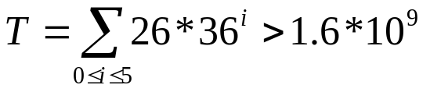
Static Hashing
Identifiers are stored in a fixed-size table called hash table.
The address of location of an identifier, x, is obtained by computing some arithmetic function h(x).
The memory available to maintain the symbol table (hash table) is assumed to be sequential.
The hash table consists of b buckets and each bucket contains s records.
h(x) maps the set of possible identifiers onto the integers 0 through b-1.
If the identifier is 6 alpha-numerical long, with the first one being a letter. Then, the total of distinct identifiers are

Slide 4
Hash Tables
Definition: The identifier density of a hash table is the ratio n/T, where n is the number of identifiers in the table and T is the total number of possible identifiers. The loading density or loading factor of a hash table is α= n/(sb).

Slide 5
Hash Tables (Cont.)
Two identifiers, I₁, and I₂, are said to be synonyms with respect to h if h(I₁) = h(I₂).
An overflow occurs when a new identifier i is mapped or hashed by h into a full bucket.
A collision occurs when two non-identical identifiers are hashed into the same bucket.
If the bucket size is 1, collisions and overflows occur at the same time.

Slide 6
Example 8.1
Slot 1
Slot 2
0
A
A2
If no overflow occur, the time required for hashing depends only on the time required to compute the hash function h.
1
2
3
D
4
5
6
GA
G
Large number of collisions and overflows!
25

Slide 7
Hash Function
A hash function, h, transforms an identifier, x, into a bucket address in the hash table.
Ideally, the hashing function should be both easy to compute and results in very few collisions.
Also because the size of the identifier space, T, is usually several orders of magnitude larger than the number of buckets, b, and s is small, overflows necessarily occur. Hence, a mechanism to handle overflow is needed.

Slide 8
Hash Function (Cont.)
Generally, a hash function should not have bias on the use of the hash table.
A uniform hash function supports that a random x has an equal chance of hashing into any of the b buckets

Slide 9
Mid-Square
Mid-Square function, h_{m}, is computed by squaring the identifier and then using an appropriate number of bits from the middle of the square to obtain the bucket address.
Since the middle bits of the square usually depend on all the characters in the identifier, different identifiers are expected to result in different hash addresses with high probability.

Slide 10
Division
Another simple hash function is using the modulo (%) operator.
An identifier x is divided by some number M and the remainder is used as the hash address for x.
The bucket addresses are in the range of 0 through M-1.
If M is a power of 2, then h_{D}(x) depends only on the least significant bits of x.

Slide 11
Division (Cont.)
If identifiers are stored right-justified with leading zeros and M = 2^{i}, i ≤ 6, the identifiers A1, B1, C1, etc., all have the same bucket.
  Because programmers tend to use many variables with the same suffix, the choice of M as a power of two would result in many collisions.
  If left-justified is used, all one-character identifiers would map to the same bucket, 0, for M = 2^{i}, i ≤ 54; all two character identifiers would map to the bucket 0 for M = 2^{i}, i ≤ 48.
If a division function h_{D} is used as the hash function, the table size should not be a power of two.
If M is divisible by two, the odd keys are mapped to odd buckets and even keys are mapped to even buckets. Thus, the hash table is biased.

Slide 12
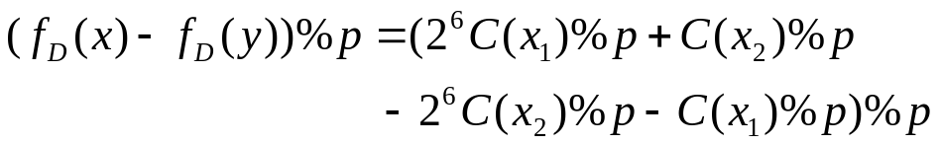
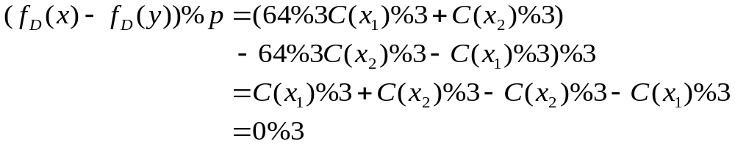
Division (Cont.)
Let x=x₁x₂ and y = x₂x₁ be two identifiers. If internal binary representation of x₁ is C(x₁) and that for x₂ has value C(x₂), then if each character is represented by six bits, the numeric value of x is 2⁶C(x₁) +C(x₂), and that for y is 2⁶C(x₂)+C(x₁).
If p is a prime number that divides M, then
If p =3, then

Slide 13
Division (Cont.)
Program in which many variables are permutations of each other would again result in a biased use of the table and hence result in many collisions.
  In the previous example, 64%3 =1 and 64%7=1.
To avoid the above problem, M needs to be a prime number. Then, the only factors of M are M and 1.

Slide 14
Folding
The identifier x is partitioned into several parts, all but the last being of the same length.
All partitions are added together to obtain the hash address for x.
  Shift folding: different partitions are added together to get h(x).
  Folding at the boundaries: identifier is folded at the partition boundaries, and digits falling into the same position are added together to obtain h(x). This is similar to reversing every other partition and then adding.

Slide 15
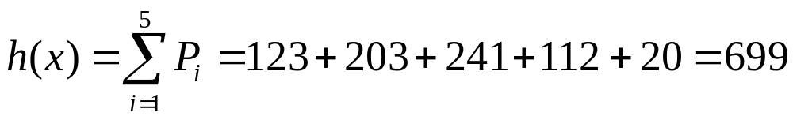
Example 8.2
x=12320324111220 are partitioned into three decimal digits long.
P1 = 123, P2 = 203, P3 = 241, P4 = 112, P5 = 20.
Shift folding:
Folding at the boundaries:
123
203
241
112
20
Folding 1 time
123
203
211
142
Folding 2 times
123
302
h(x) = 123 + 302 + 241 + 211 + 20 = 897
211
241

Slide 16
Digit Analysis
This method is useful when a static file where all the identifiers in the table are known in advance.
Each identifier x is interpreted as a number using some radix r.
The digits of each identifier are examined.
Digits having most skewed distributions are deleted.
Enough digits are deleted so that the number of remaining digits is small enough to give an address in the range of the hash table.

Slide 17
Overflow Handling
There are two ways to handle overflow:
  Open addressing
  Chaining

Slide 18
Open Addressing
Assumes the hash table is an array
The hash table is initialized so that each slot contains the null identifier.
When a new identifier is hashed into a full bucket, find the closest unfilled bucket. This is called linear probing or linear open addressing

Slide 19
Example 8.3
Assume 26-bucket table with one slot per bucket and the following identifiers: GA, D, A, G, L, A2, A1, A3, A4, Z, ZA, E. Let the hash function h(x) = first character of x.
When entering G, G collides with GA and is entered at ht[7] instead of ht[6].
0
A
1
A2
2
A1
3
D
4
A3
5
A4
6
GA
7
G
8
ZA
9
E
25

Slide 20
Open Addressing (Cont.)
When linear open address is used to handle overflows, a hash table search for identifier x proceeds as follows:
  compute h(x)
  examine identifiers at positions ht[h(x)], ht[h(x)+1], …, ht[h(x)+j], in this order until one of the following condition happens:
    ht[h(x)+j]=x; in this case x is found
    ht[h(x)+j] is null; x is not in the table
    We return to the starting position h(x); the table is full and x is not in the table

Slide 21
Linear Probing
In example 8.3, we found that when linear probing is used to resolve overflows, identifiers tend to cluster together. Also adjacent clusters tend to coalesce. This increases search time.
  e.g., to find ZA, you need to examine ht[25], ht[0], …, ht[8] (total of 10 comparisons).
  To retrieve each identifier once, a total of 39 buckets are examined (average 3.25 bucket per identifier).
The expected average number of identifier comparisons, P, to look up an identifier is approximately (2 -α)/(2-2α), whereαis the loading density.
Example 8.3 α=12/26=.47 and P = 1.5.
Even though the average number of probes is small, the worst case can be quite large.
0
A
1
A2
2
A1
3
D
4
A3
5
A4
6
GA
7
G
8
ZA
9
E
25
Z

Slide 22
Quadratic Probing
One of the problems of linear open addressing is that it tends to create clusters of identifiers.
These clusters tend to merge as more identifiers are entered, leading to bigger clusters.
A quadratic probing scheme improves the growth of clusters. A quadratic function of i is used as the increment when searching through buckets.
Perform search by examining bucket h(x), (h(x)+i²)%b, (h(x)-i²)%b for 1 ≤ i ≤ (b-1)/2.
When b is a prime number of the form 4j+3, for j an integer, the quadratic search examine every bucket in the table.

Slide 23
Rehashing
Another way to control the growth of clusters is to use a series of hash functions h₁, h₂, …, h_{m}. This is called rehashing.
Buckets h_{i}(x), 1 ≤ i ≤ m are examined in that order.

Slide 24
Chaining
We have seen that linear probing perform poorly because the search for an identifier involves comparisons with identifiers that have different hash values.
  e.g., search of ZA involves comparisons with the buckets ht[0] – ht[7] which are not possible of colliding with ZA.
Unnecessary comparisons can be avoided if all the synonyms are put in the same list, where one list per bucket.
As the size of the list is unknown before hand, it is best to use linked chain.
Each chain has a head node. Head nodes are stored sequentially.

Slide 25
Hash Chain Example
ht
0
A4
A3
A1
A2
A
0
1
0
2
0
3
D
0
4
E
0
5
0
6
G
GA
0
7
0
8
0
Average search length is (6*1+3*2+1*3+1*4+1*5)/12 = 2
9
0
10
0
11
L
0
25
ZA
Z
0

Slide 26
Chaining (Cont.)
The expected number of identifier comparisons can be shown to be ~ 1 +α/2, where αis the loading density n/b (b=number of head nodes). For α=0.5, it’s 1.25. And if α=1, then it’s about 1.5.
Another advantage of this scheme is that only the b head nodes must be sequential and reserved at the beginning.
The scheme only allocates other nodes when they are needed. This could reduce overall space requirement for some load densities, despite of links.

Slide 27
Hash Functions
Theoretically, the performance of a hash table depends only on the method used to handle overflows and is independent of the hash function as long as an uniform hash function is used.
In reality, there is a tendency to make a biased use of identifiers.
Many identifiers in use have a common suffix or prefix or are simple permutations of other identifiers.
  Therefore, different hash functions would give different performance.

Slide 28
Average Number of Bucket Accesses Per Identifier Retrieved
a = n/b | 0.50 | 0.75 | 0.90 | 0.95
Hash Function | Chain Open | Chain Open | Chain Open | Chain Open
mid square | 1.26 1.73 | 1.40 9.75 | 1.45 37.14 | 1.47 37.53
division | 1.19 4.52 | 1.31 7.20 | 1.38 22.42 | 1.41 25.79
shift fold | 1.33 21.75 | 1.48 65.10 | 1.40 77.01 | 1.51 118.57
bound fold | 1.39 22.97 | 1.57 48.70 | 1.55 69.63 | 1.51 97.56
digit analysis | 1.35 4.55 | 1.49 30.62 | 1.52 89.20 | 1.52 125.59
theoretical | 1.25 1.50 | 1.37 2.50 | 1.45 5.50 | 1.48 10.50

Slide 29
Theoretical Evaluation of Overflow Techniques
In general, hashing provides pretty good performance over conventional techniques such as balanced tree.
However, the worst-case performance of hashing can be O(n).
Let ht[0..b-1] be a hash table with b buckets. If n identifiers x₁, x₂, …, x_{n} are entered into the hash table, then there are b^{n} distinct hash sequences h(x₁), h(x₂), …, h(x_{n}).

Slide 30
Theoretical Evaluation of Overflow Techniques (Cont.)
S_{n} is the average number of comparisons neede to find the jth key x_{j}, averaged over 1 ≤ j ≤ n, with each j equally likely, and averaged over all b^{n} hash sequences, assuming each of these also to be equally likely.
U_{n} is the expected number of identifier comparisons when a search is made for an identifier not in the hash table.

Slide 31
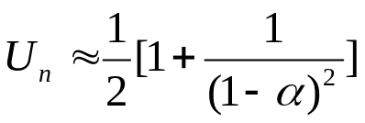
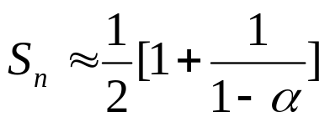
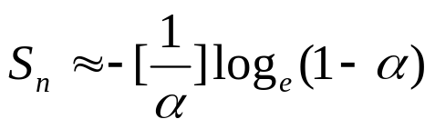



Theorem 8.1
Theorem 8.1: Let α=n/b be the loading density of a hash table using a uniform hashing function h. Then
for linear open addressing
for rehashing, random probing, and quadratic probing
for chaining

Slide 32
Dynamic Hashing
The purpose of dynamic hashing is to retain the fast retrieval time of conventional hashing while extending the technique so that it can accommodate dynamically increasing and decreasing file size without penalty.
Assume a file F is a collection of records R. Each record has a key field K by which it is identified. Records are stored in pages or buckets whose capacity is p.
The goal of dynamic hashing is to minimize access to pages.
The measure of space utilization is the ratio of the number of records, n, divided by the total space, mp, where m is the number of pages.

Slide 33
Dynamic Hashing Using Directories
Given a list of identifiers in the following:
Now put these identifiers into a table of four pages. Each page can hold at most two identifiers, and each page is indexed by two-bit sequence 00, 01, 10, 11.
Now place A0, B0, C2, A1, B1, and C3 in a binary tree, called Trie, which is branching based on the last significant bit at root. If the bit is 0, the upper branch is taken; otherwise, the lower branch is taken. Repeat this for next least significant bit for the next level.
Identifiers | Binary representation
A0 | 100 000
A1 | 100 001
B0 | 101 000
B1 | 101 001
C0 | 110 000
C1 | 110 001
C2 | 110 010
C3 | 110 011
C5 | 110 101

Slide 34
A Trie To Hold Identifiers
0
A0, B0
0
A0, B0
0
1
C2
0
1
C2
0
A1, B1
1
0
A1, B1
0
1
1
C5
1
C3
1
C3
(a) two-level trie on four pages
0
A0, B0
0
(b) inserting C5 with overflow
1
C2
0
A1, C1
0
1
0
1
B1
C5
(c) inserting C1 with overflow
1
1
C3

Slide 35
Issues of Trie Representation
From the example, we find that two major factors that affects the retrieval time.
  Access time for a page depends on the number of bits needed to distinguish the identifiers.
  If identifiers have a skewed distribution, the tree is also skewed.

Slide 36
Extensible Hashing
Fagin et al. present a method, called extensible hashing, for solving the above issues.
  A hash function is used to avoid skewed distribution. The function takes the key and produces a random set of binary digits.
  To avoid long search down the trie, the trie is mapped to a directory, where a directory is a table of pointers.
  If k bits are needed to distinguish the identifiers, the directory has 2^{k} entries indexed 0, 1, …, 2^{k}-1
  Each entry contains a pointer to a page.

Slide 37
Trie Collapsed Into Directories
a
a
a
000
A0, B0
0000
c
A0, B0
00
A0, B0
c
0001
A1, C1
c
b
01
A1, B1
001
A1, B1
0010
f
C2
b
b
0011
10
C2
010
C2
a
C3
d
e
0100
11
C3
011
C3
0101
e
a
b
C5
100
0110
f
d
0111
101
C5
a
b
1000
d
110
1001
B1
c
b
111
1010
f
1011
a
1100
e
1101
b
1110
f
1111
(a) 2 bits
(b) 3 bits
© 4 bits

Slide 38
Hashing With Directory
Using a directory to represent a trie allows table of identifiers to grow and shrink dynamically.
Accessing any page only requires two steps:
  First step: use the hash function to find the address of the directory entry.
  Second step: retrieve the page associated with the address
Since the keys are not uniformly divided among the pages, the directory can grow quite large.
To avoid the above issue, translate the bits into a random sequence using a uniform hash function. So identifiers can be distributed uniformly across the entries of directory. In this case, multiple hash functions are needed.

Slide 39
Overflow Handling
A simple hash function family is simply adding a leading zero or one as the new leading bit of the result.
When a page identified by i bits overflows, a new page needs to be allocated and the identifiers are rehashed into those two pages.
Identifiers in both pages should have their low-order I bits in common. These are referred as buddies.
If the number of identifiers in buddy pages is no more than the capacity of one page, then they can be coalesce into one page.
After adding a bit, if the number of bits used is greater than the depth of the directory, the whole directory doubles in size and its depth increases by 1.

Slide 40
Program 8.5 Extensible Hashing
const int WordSize = 5; // maximum no. of directory bits
const int PageSize = 10; // maximum size of a page
struct TwoChars { char str[2];};
struct page {
int LocalDepth; // no. of bits to distinguish ids
TwoChars names[PageSize]; //the actual identifiers
int NumIdents; // no. of identifiers in this page
};
typedef page* paddr;
struct record { // a sample record
TwoChars KeyField;
int IntData;
char CharData;
};
paddr rdirectory[MaxDir]; // will contain pointers to pages
int gdepth; // not to exceed WordSize

Slide 41
Program 8.5 Extensible Hashing (Cont.)
paddr hash(const TwoChars& key, const int precision);
// key is hashed using a uniform hash function, and the low order precision bits are returned
//as the page address
paddr buddy(const paddr index);
// Take an address of a page and return the page’s buddy; i.e., the leading bit it complemented
int size(const paddr ptr);
// Return the number of identifiers in the page
paddr coalesce(const paddr ptr, const paddr buddy);
// Combine page ptr and buddy, buddy into a single page
Boolean PageSearch(const TwoChars& key, const paddr index);
// Search page index for key key. If found, return TRUE; otherwise, return FALSE.
int convert(const paddr p);
// Convert a pointer to a page to an equivalent integer

Slide 42
Program 8.5 Extensible Hashing (Cont.)
void enter(const record r, const paddr p);
// Insert the new record r into the page pointed at by p
void PageDelete(const TwoChars& key, const paddr p);
// Remove the record with key key from the page pointed at by p
paddr find(const TwoChars& key);
// Search for a record with key key in the file. If found, return the address of the page in which it was
// found. If not return 0.
{
paddr index = hash(key, gdepth);
int IntIndex = convert(index);
padd ptr = rdirectory[IntIndex];
if (PageSearch(key, ptr) retrun ptr;
else return 0;
}

Slide 43
Program 8.5 Extensible Hashing (Cont.)
void insert(const record& r, const TwoChars& key)
// Insert a new record into the file pointed at by the directory
{
paddr p = find(key); // check if key is present
if(p) return; // key already in
if(p->NumIdents != PageSize) { // page not full
enter(r, p); p->NumIdents ++;
}
else {
Split the page into two, insert the new key, and update gdepth if necessary; if this causes gdepth
to exceed WordSize, print an error and terminate.
}
}
void Delete(const TwoChars& key)
//Find and delete the record with key key
{
paddr p = find(key);
if(p) {
PageDelete(key, p);
if ((size(p) + size(buddy(p)) <= PageSize) coalesce(p, buddy(p));
}
}

Slide 44
Analysis of Directory-Based Dynamic Hashing
The most important of the directory version of extensible hashing is that it guarantees only two disk accesses for any page retrieval.
We get the performance at the expense of space. This is because a lot of pointers could point to the same page.
One of the criteria to evaluate a hashing function is the space utilization.
Space utilization is defined as the ratio of the number of records stored in the table divided by the total number of space allocated.
Research has shown that dynamic hashing has 69% of space utilization if no special overflow mechanisms are used.

Slide 45
Directoryless Dynamic Hashing
Directoryless hashing (or linear hashing) assume a continuous address space in the memory to hold all the records. Therefore, the directory is not needed.
Thus, the hash function must produce the actual address of a page containing the key.
Contrasting to the directory scheme in which a single page might be pointed at by several directory entries, in the directoryless scheme one unique page is assigned to every possible address.

Slide 46
A Trie Mapped To Directoryless, Continuous Storage
0
A0, B0
00
A0
B0
0
1
C2
01
C2
-
10
A1
1
0
A1, B1
B1
11
C3
1
C3
-

Slide 47
Directoryless Scheme Overflow Handling
00
A0
000
A0
000
A0
B0
B0
overflow page
B0
01
C2
001
C2
001
C2
-
-
-
10
A1
010
A1
010
A1
B1
B1
C5
B1
C1
C5
11
C3
011
C3
011
C3
-
-
-
100
-
100
-
-
new page
-
new page
101
-
-

Slide 48
Figure 8.14 The rth Phase of Expansion of Directoryless Method
pages already split
pages not yet split
pages added so far
addresses by r+1 bits
addresses by r bits
addresses by r+1 bits
q
r
2^{r} pages at start

Slide 49
Analysis of Directoryless Hashing
The advantage of this scheme is that for many retrievals the time is one access for those identifiers that are in the page directly addressed by the hash function.
The problem is that for others, substantially more than two accesses might be required as one moves along the overflow chain.
Also when a new page is added and the identifiers split across the two pages, all identifiers including the overflows are rehashed.
Hence, the space utilization is not good, about 60%. (shown by Litwin).

